Slide 1
IFT6759 - Project 1
Solar Irradiance Prediction
Alex Peplowski
Harmanpreet Singh
Marc-Antoine Provost
Mohammed Loukili

Slide 2
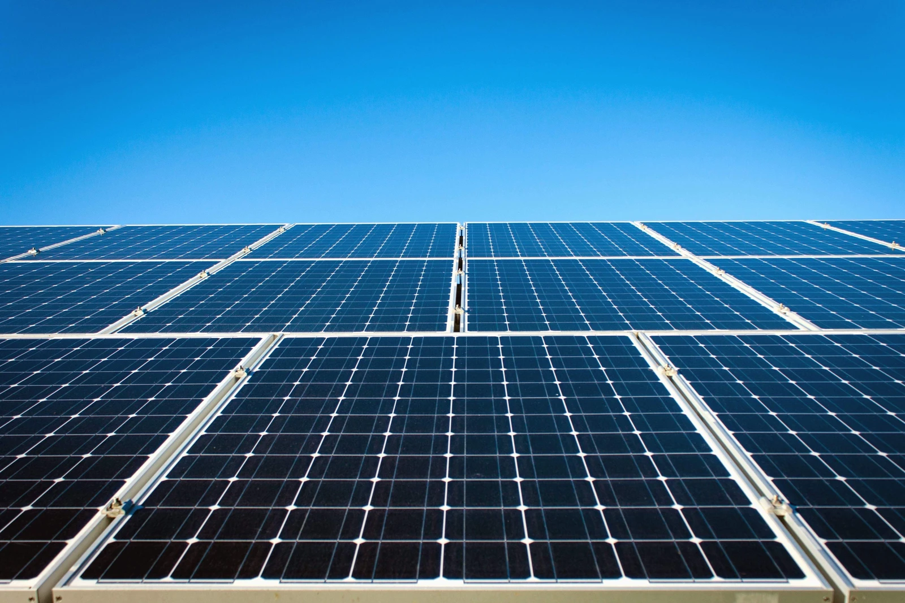
Project Description
With the surge of perturbations that climate change has brought in the last years, the need for energy diversification has risen.
Better solar irradiance forecasting would ensure efficient management of photovoltaic energy, i.e storing energy while in maximum solar irradiance.

Slide 3
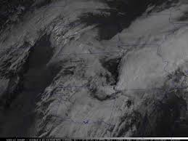
Project Description
Solar Irradiance : power per unit area (watt per square meter, W/m²), received from the Sun in the form of electromagnetic radiation” - Wikipedia
Using satellite imagery and other metadata such as datetime, station ID, etc., predict GHI values up to 6 hours in the future at specific points on the map.
T = T₀, T = T₀+ 1h, T = T₀+ 3h, T = T₀+ 6h.
GHI values:
T₀ = 433.2 W/m²
T₀+ 1h = 443.5 W/m²
T₀+ 3h = 263.1 W/m²
T₀+ 6h = -3.2 W/m²

Slide 4
Data Ingestion/Preprocessing

Slide 5
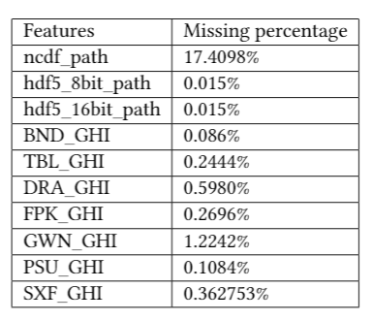
Dealing with NaNs
Even though hdf5_path has less NaN we should only consider dataframe observations where the ncdf_path is not null.

Slide 6
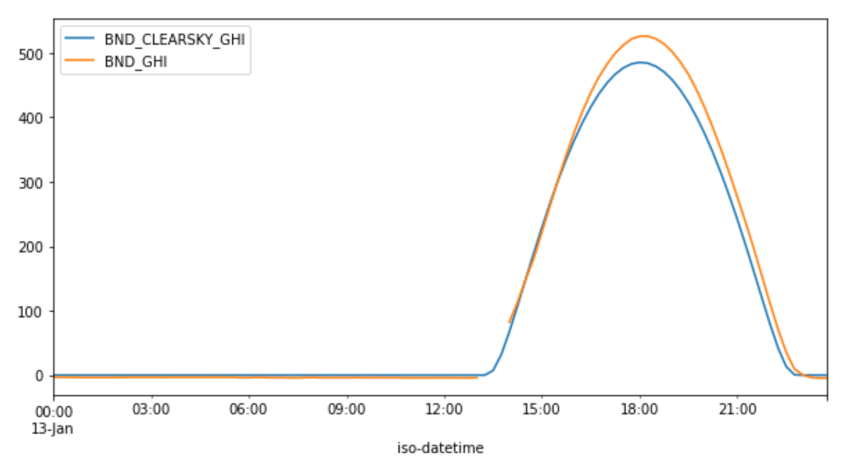
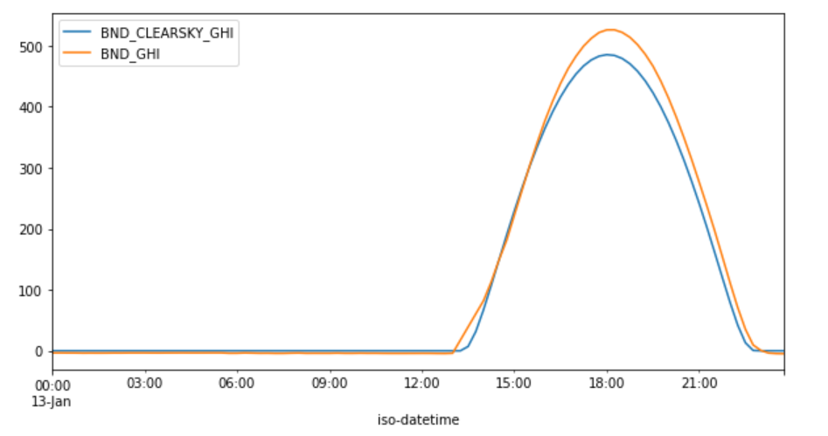
Dealing with NaNs
We interpolated missing GHIs using a linear interpolation based on the previous and next occurrence of valid data.
Notes:
We also dropped nighttime observations for training, replaced string nans, shuffled the dataframe

Slide 7
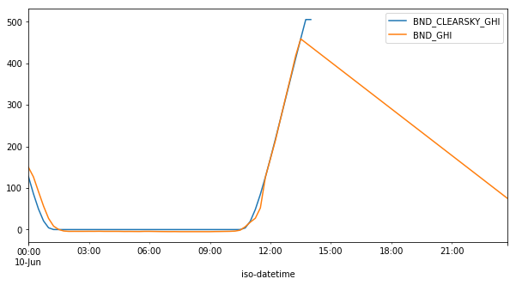
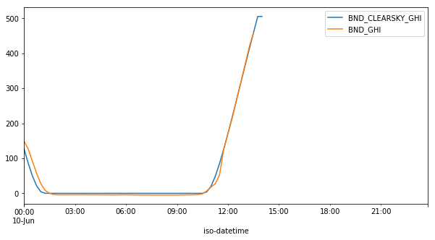
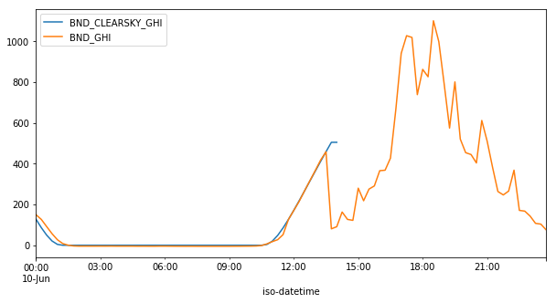
Dealing with NaNs
We interpolated missing GHIs using a mean interpolation based on the previous and next day of valid data.
Linear interpolation
Mean interpolation
Several missing hours
Notes:
We also dropped nighttime observations for training, replaced string nans, shuffled the dataframe

Slide 8
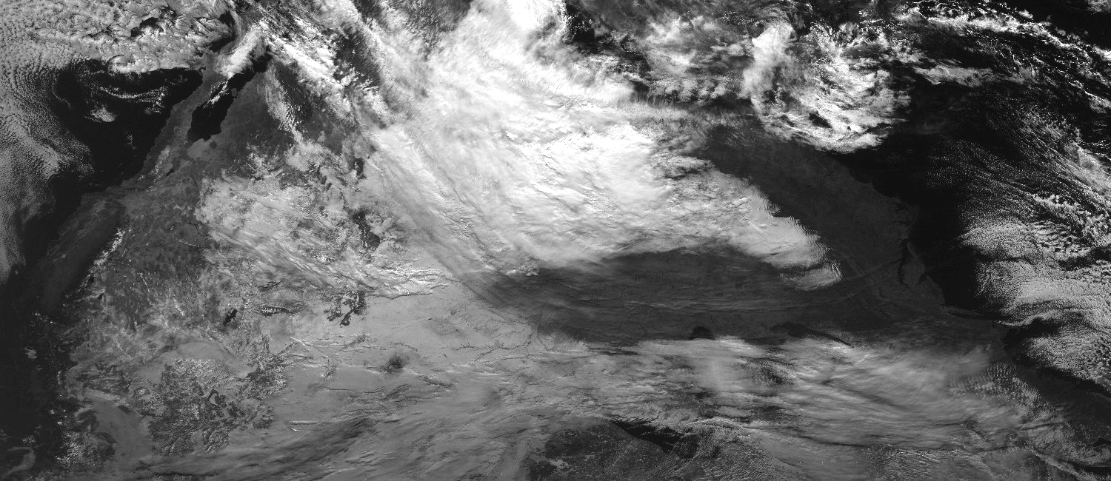
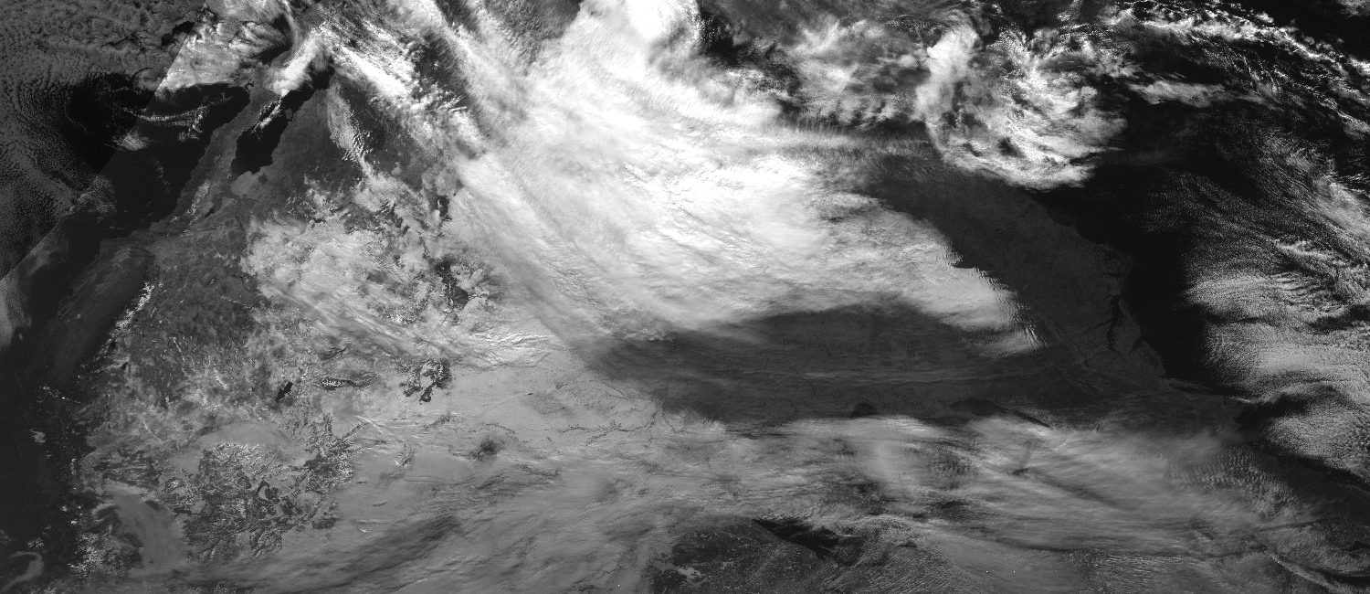
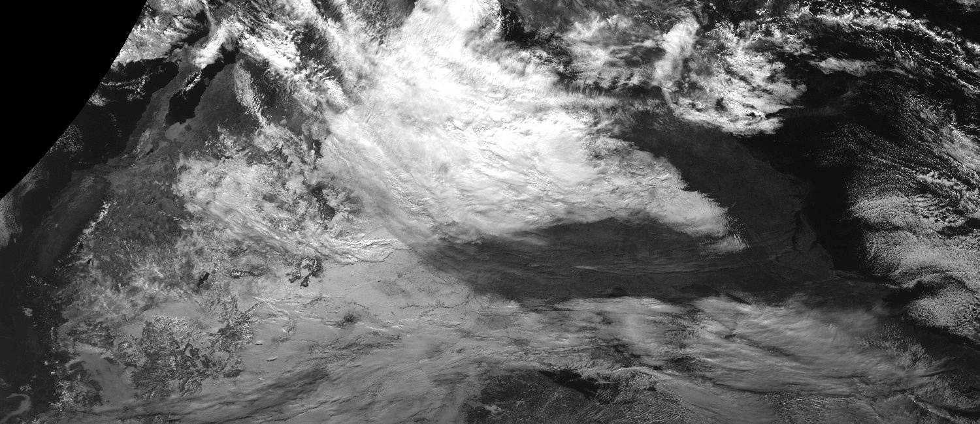
Dealing with missing images
We experienced with interpolating missing images by using a linear interpolation pixels-wise from previous and next available images:
Interpolate
missing image
Previous image
Interpolated image
Next image
Notes:
We also dropped nighttime observations for training, replaced string nans, shuffled the dataframe

Slide 9
Cropping Strategy
How many pixels to keep?
Over how many pixels a cloud can travel in 6 hours?
½ Ideal image size =
6 hours * Cloud speed km/hr * pixels/km
Average cloud speed: 64km/hr
Max cloud speed: 160km/hr
GOES-13 Pixel density:
16km/px
Image sizes:
Average case: 48 pixels
Worst case: 120 pixels

Slide 10
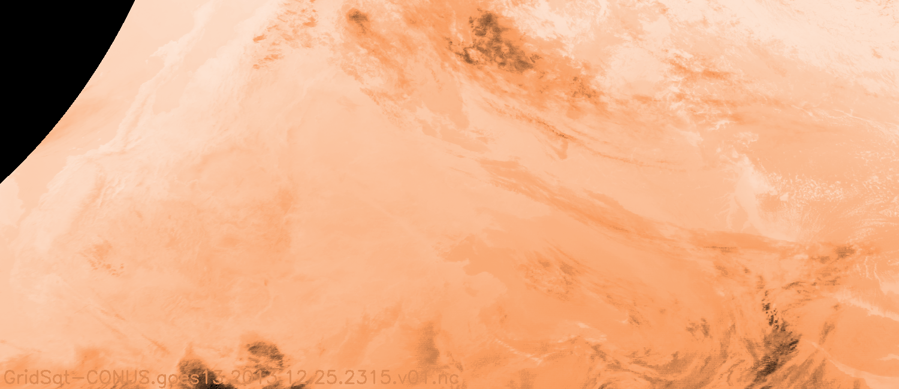
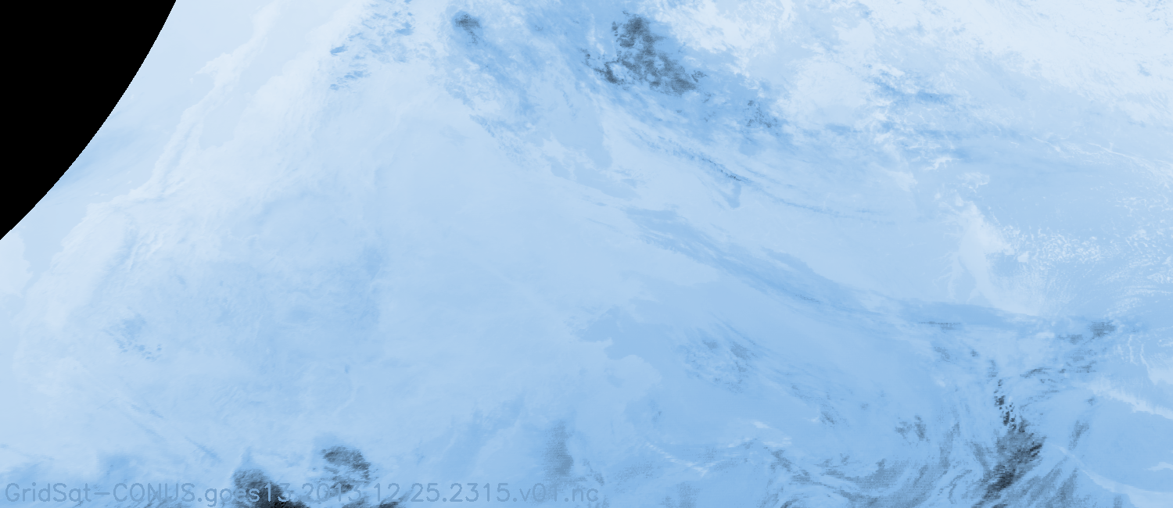
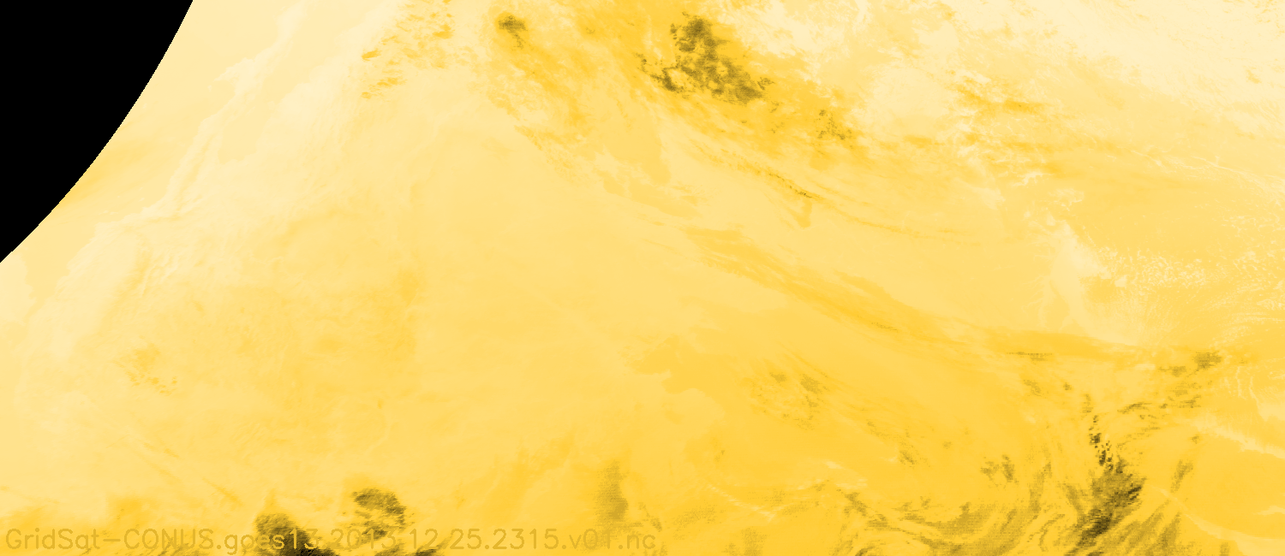
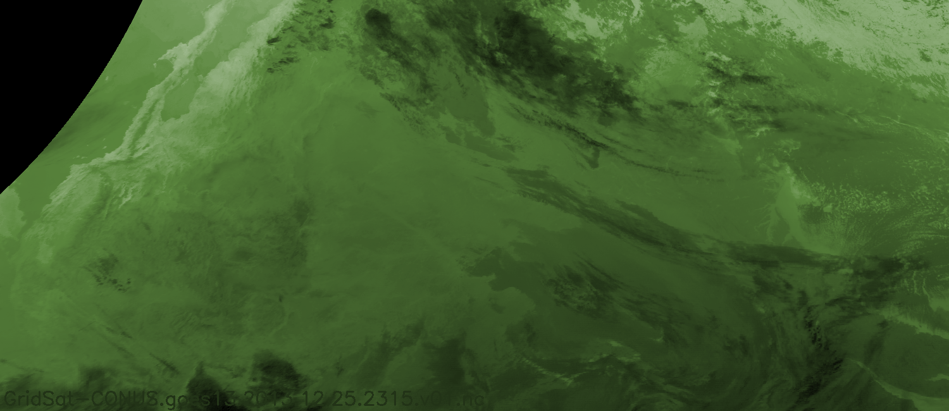
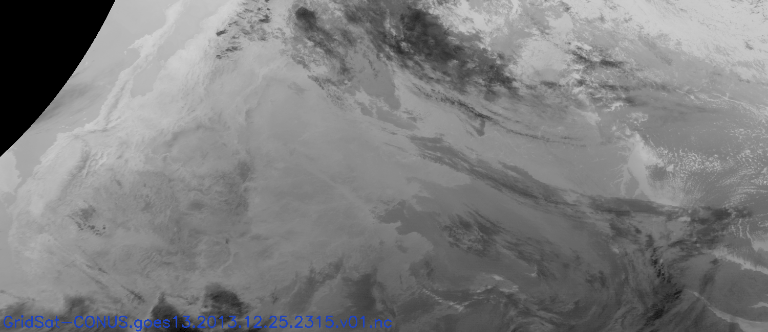
Cropping
In order to capture the dynamics of atmospheric phenomena, we considered a sequence length of past 2 images with a window size of 41. Thus, our input image is of size (82,82,5).
T₀ - Δ₂
...
T₀ - Δ₁
...
T₀
channels
channels
channels
Time
If there was any missing image in the pre-defined sequence length, we replaced those with the image at T₀

Slide 11
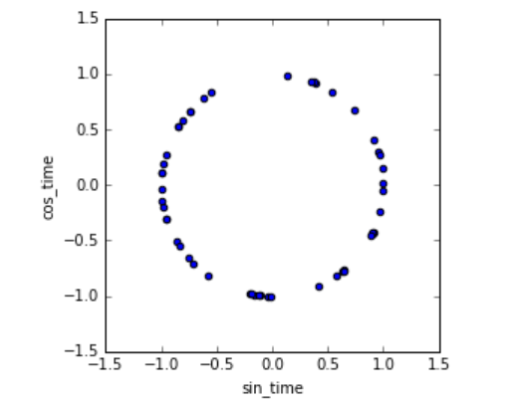
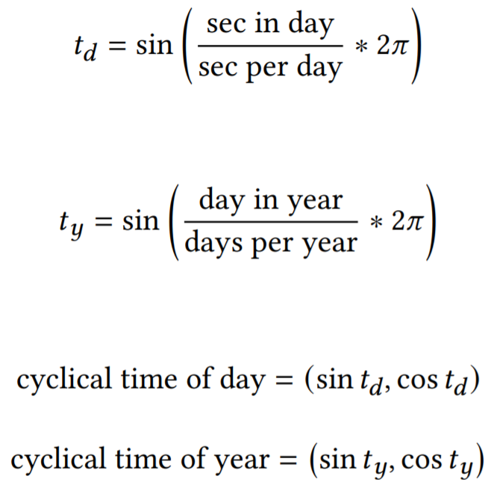
Encoding cyclical features
Sin and cosine transformation - time of day & day of year

Slide 12
Models + Architectures

Slide 13
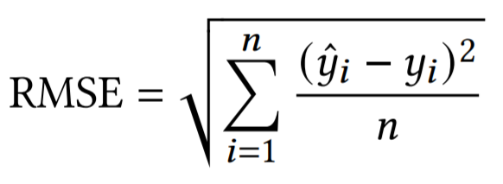
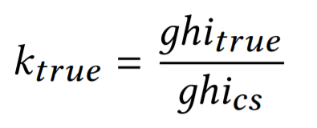
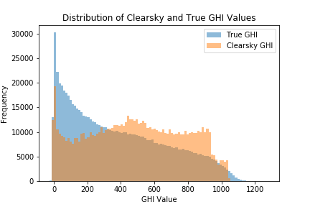
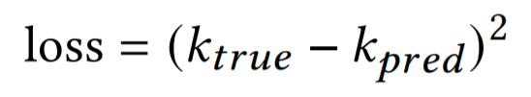
Loss Function Definition
Metric of Interest: GHI RMSE
Model Target: Clearsky ratio!
Clearsky ratio
MSE Loss:
Use sigmoid output activation function to predict k!

Slide 14
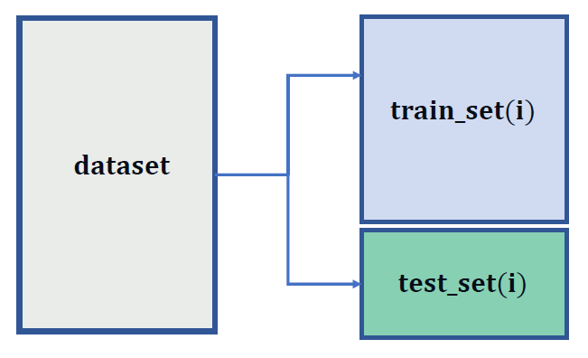
Cross-Validation Strategy
Train on all data from 2010-2014
Hold out 2015 for validation

Slide 15
Input Features
Input features :
Past 3 cropped images centered around station coordinates
Clearsky value GHIs for T_{0,} T_{1,} T_{3,} T₆
Cyclical time of day
Cyclical time of year

Slide 16
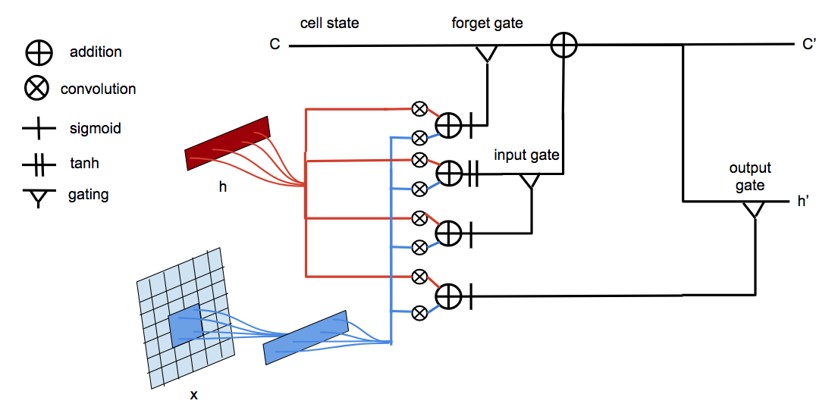
Models tried
Convolutional LSTM

Slide 17
3D CNN - Architecture
Other notes:
Batch normalization after all CNN, FC layers
RELU activation after batch normalization
Sigmoid activation for output layer

Slide 18
Results
Model hyperparameters:
K-inflation: 10%
1024 Dense Units
3 Input Images @ t=0, -30 min, -60 min
1 Conv3D, 5 Conv2D layers
Train/Test Loss
Loss
Other hyperparameters searched:
Epoch
Model Description | Best Validation RMSE
Best Model (above) | 110.2
Use 2048 Dense Units | 111.5
Use 5 Input Images | 112.2
Use onehot station IDs | 110.9
Train/Test RMSE
RMSE
Epoch

Slide 19

Conclusion
Best model : 3D-CNN
Future work :
Hyperparameter tuning with Orion
Include image interpolation
Weather API
Other models (ResNet, etc.)
Notes:
Synthesis of findings, obstacles, and recommandations
Models had worked best
How initialization is the best
Which parts if the image are the most used: heat-map
Equation of the clear sky model
Check the grammar of the report
Most influential features and parameters

